Slide 1
WEB Technology project: GAmexcorner
By: Tanvit Singh
20cs3065

Slide 2
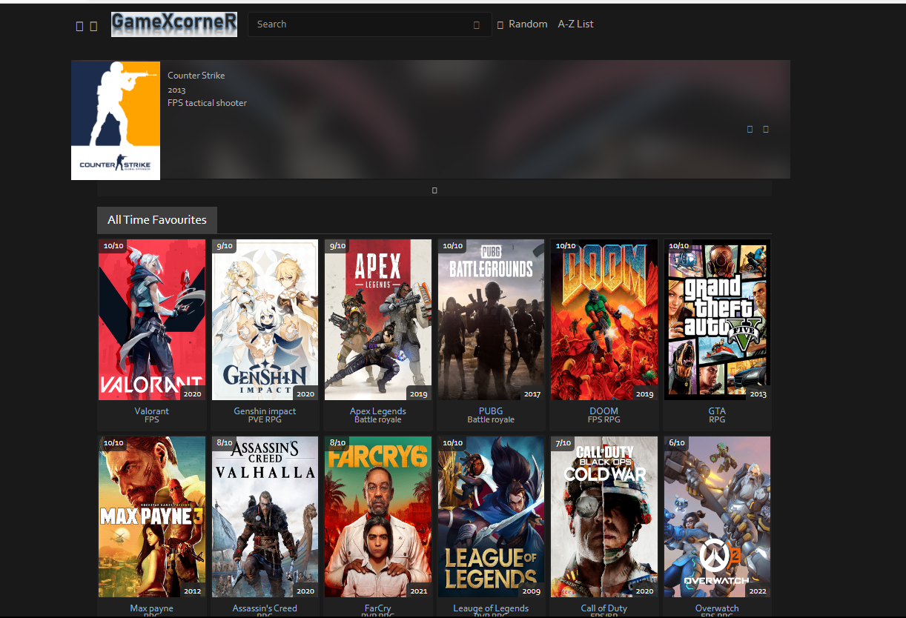
HOMEPAGE LOOK
MY all time favourite Games

Slide 3
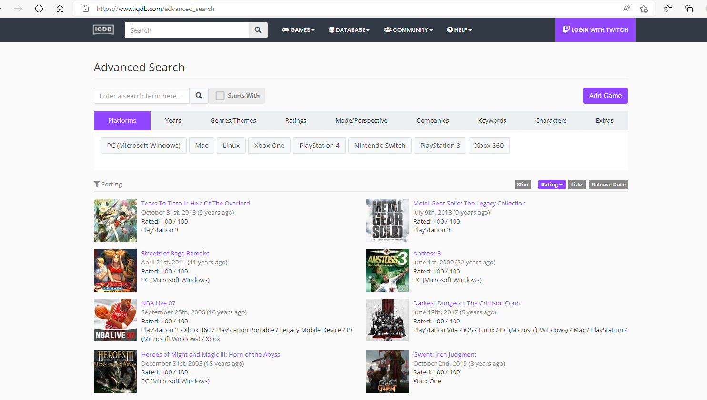
IGDB Database after clicking A-Z list button

Slide 4
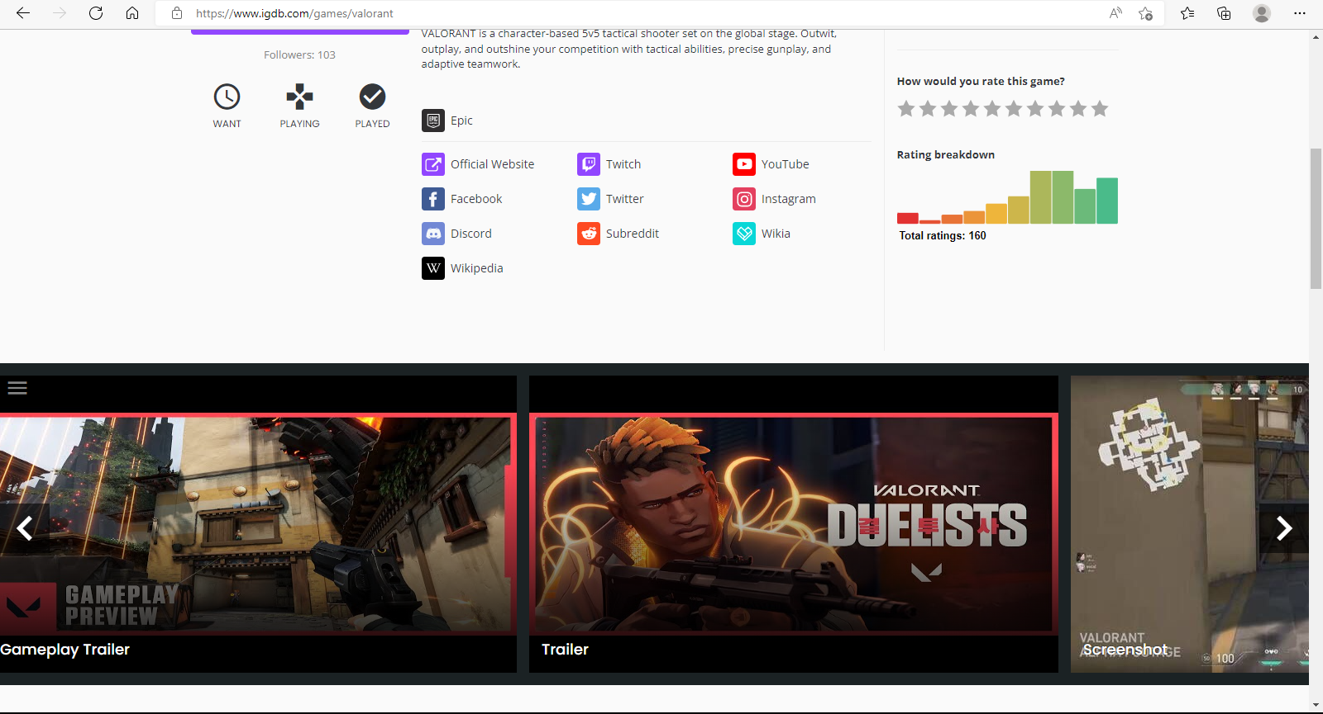
OFFICIAL WEBSITE,DOWNLOAD LINKS,GAME INFORMATION,TRAILERS AND REVIEWS ARE PRESENT HERE, YOU JUST HAVE TO CLICK ON THE GAME FROM HOMEPAGE

Slide 5

SEARCHBAR TO FIND ANY GAME YOU LIKE FROM IGDB DATABASE
RANDOM BUTTON TO GET ANY RANDOM GAME FROM IGDB DATABASE

Slide 6
IDEA :
Video game piracy is the unauthorized copying and distributing of video game software, and is a form of copyright infringement. It is often cited as a major problem that video game publishers face when distributing their products, due to the ease of being able to distribute games for free, via torrenting or websites offering direct download links . Right holders generally attempt to counter piracy of their products by enforcing the Digital Millennium Copyright Act, though this has never been totally successful . Piracy directly compromises revenue, as evidenced by a 2011 UKIE report, detailing how video game piracy using modified consoles cost publishers at least £1.45 billion (approximately $2.3 billion) the previous year . UKIE also estimated that there was a 4:1 (2.3 * 4 = $9.2 billion) ratio of pirated copies to legitimate copies of games, with the aforementioned monetary figure only being drawn from a conservative 1:1 ratio . Digital distribution of pirated games has historically occurred on bulletin board systems (BBS), and more recently via decentralized peer-to-peer torrenting . In terms of physical distribution, Taiwan, China and Malaysia are known for major manufacturing and distribution centers for pirated game copies, while Hong Kong and Singapore are major importers.
As of many people download pirated copies of games resulting in loss of profit to the developer and security issues to the user. This webpage provide authentic download links for games and some minor information about the games.
Increasing awareness against piracy of games among users.

Slide 7
Approach :
First I created a basic HTML page and then applied CSS on it for styling.
Then I created multiple div and positioned them using UL and CSS . These div contains some of my favourite games and then I linked them with their respective IGDB page providing information about the games.
A search bar that can be used to search any game in existing IGDB database using Twitch API and recommends game of same Genres, Year of release and Developer studio.
A random button to select any random game from the database.
A-Z list button that links to the main database of IGDB
Java script file for functions of buttons, search bar and Twitch API.

Slide 8
REFRENCES USED :
IGDB DATABASE-
The Internet Game Database (IGDB) is an online database managed by Twitch dedicated to gathering all information and media about video games and those working in the industry. Their agenda is to "gather, save and distribute knowledge about games", "gather gamers and the gaming industry together", and to "focus on users and let them be involved in deciding on designs and features".
The project started in 2006 as an idea, was launched as a closed beta version in 2012 and then switched to an open beta version in April 2015. In early 2016, IGDB's employees began (8 Dudes in a Garage AB) to work on the website full time and moved to an office in Gothenburg, Sweden.
The company's first investor was Nascent Invest, an investment company owned by DIF Football's former CEO Johan Ahlborg and run by CEO Erik Gozzi . Subsequently, Anton Westbergh has contributed capital via his Inwestbergh. He founded the game developer Coffee Stain Studios which is known for the successful game Goat Simulator . In February 2018, it was clear that Goodbye Kansas Game Invest and Almi Invest West would be the next external investors.
From 2015 - July 2018, IGDB's users have collected and listed 179,267 games, 15,497 game companies and 152,765 game developers.
IGDB today has many different functions with everything from news and reviews to media and a feed for users. Each game on the website has its own page where you can evaluate the game via your account, rewrite it and see recommendations for similar titles. For recommendations, IGDB has partnered with Kinrate Games to get as personal results as possible. ^{[ 8 ]}
In addition to the website, IGDB has released two apps called IGDB Pocket and IGDB Pulse. Pocket (available for Android and iOS) is the website in a pocket format where you can search, explore and save games that you are interested in. With pocket you can also create your own lists, review and rate. Pulse is an Android app that provides personal gaming news. Both of these apps are completely free from ads.
In 2018, the company decided to invest more in its data and use it for deeper analyzes. The purpose is to work more closely with both large and small companies in the industry and help them find their way in a world full of information.

